Slide 1
Interface Description Language (IDL)
Srikanth Gunturu
Guest Faculty
BITS, WILP

Slide 2
In this segment
CORBA IDL
IDL Overview
Parameters
Modules
Exceptions
Structs and Arrays
Sequences
Attributes
IDL to Java bindings

Slide 3
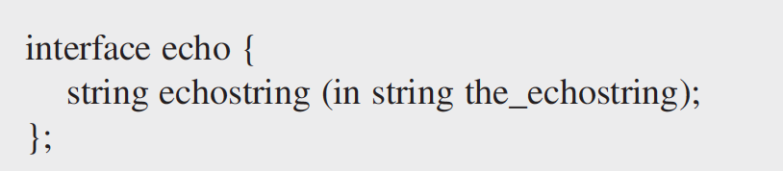
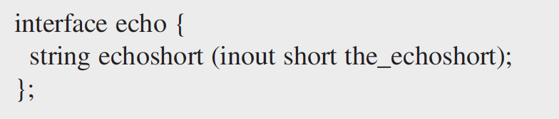
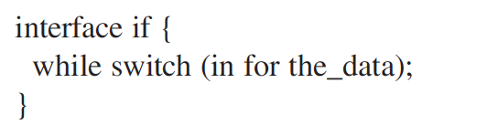

Interface Description Language (IDL)
Overview
Defines methods in a fashion similar to interfaces in Java
Implementation is internal to the server (and transparent to client)
Data types supported:
String
Integer
short – 16 bit (signed / unsigned)
long – 32 bit (signed / unsigned)
long long – 64 bit (signed / unsigned)
Octet – 8 bit (similar to byte)
No keyword restrictions for naming (as IDL is language neutral), however there may be compiling issues depending on languages involved
Enums – Order not guaranteed

Slide 4
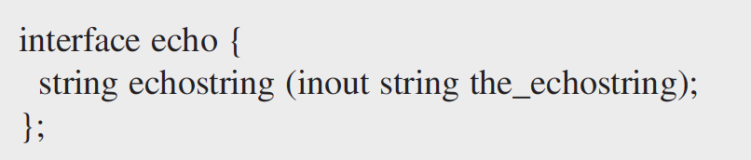
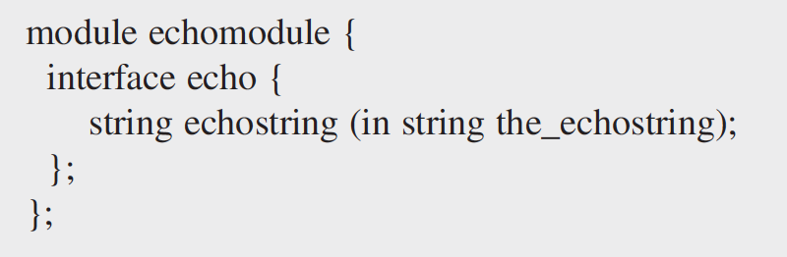
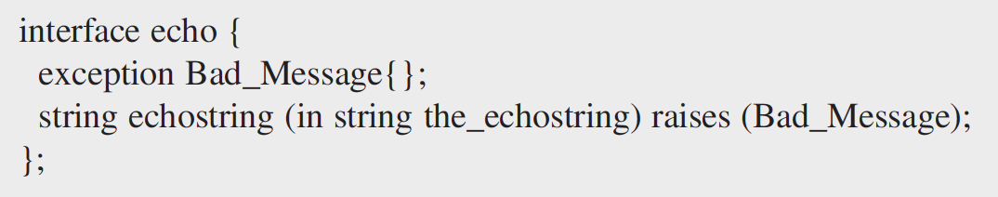
Interface Description Language (IDL)
Parameters, Modules and Exceptions
Parameters
‘in’ is input – from client to server
‘out’ is output – from server to client
‘inout’ – same parameter sent from client is used for output (similar to pass by reference)
Modules – Groups multiple interfaces together, with hierarchical naming (like Java packages)
Exceptions
System Defined
COMM_FAILURE
MARSHAL
BAD_PARAM
OBJECT_NOT_EXIST
TRASNIENT
UNKNOWN
User defined

Slide 5
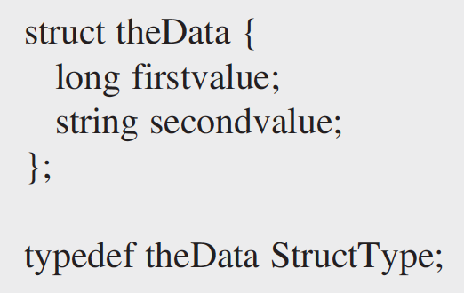
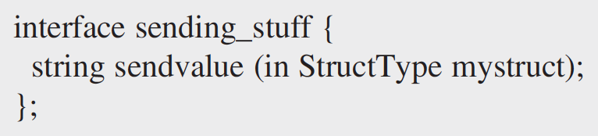
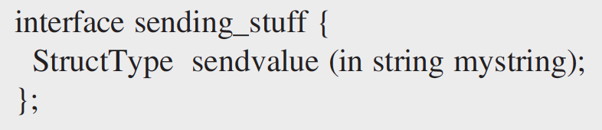
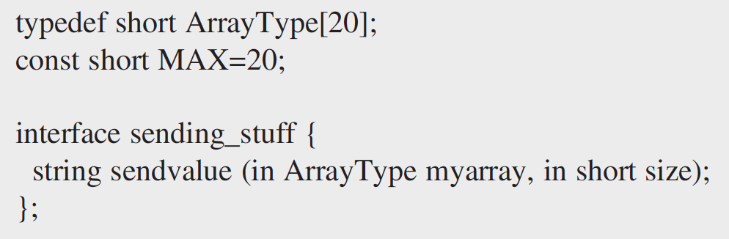
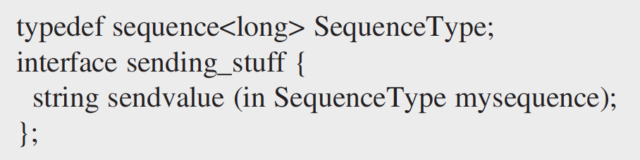
Interface Description Language (IDL)
Structs, Arrays and Sequences as Params
Structs as params
Can be used as in, out and inout
Arrays as params
No guarantee on array indexing
Sequence as params
Sends only the data present in the sequence at the time of method call

Slide 6
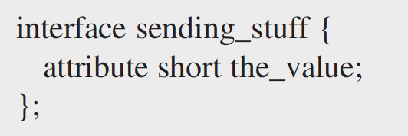
Interface Description Language (IDL)
Attributes
Attribute gets/sets a particular variable on the servant
Example:
A remote procedure named the_value with no parameters passed, that returns a Short value
A remote procedure named the_value with a Short value passed as a parameter, that does not return any values (has a void value as the return value)
Not recommended to use as behavior is too dependent on network and language implementations.

Slide 7
Interface Description Language (IDL)
CORBA IDL to Java bindings
Module in IDL maps to package in Java
CORBA IDL types map to most Java types
boolean to Boolean
octet to Byte
short to short
long to int
long long to long
string to string
sequences and arrays to arrays
float to float
double to double
enums, structs, unions and exceptions to Java classes
For user defined types in IDL, Java generates:
Helper class – manages read/write to CORBA I/O streams
Holder class – Implements out/inout parameters as a wrapper class, to hold their value (by reference) and pass it to Helper class streams

Slide 8
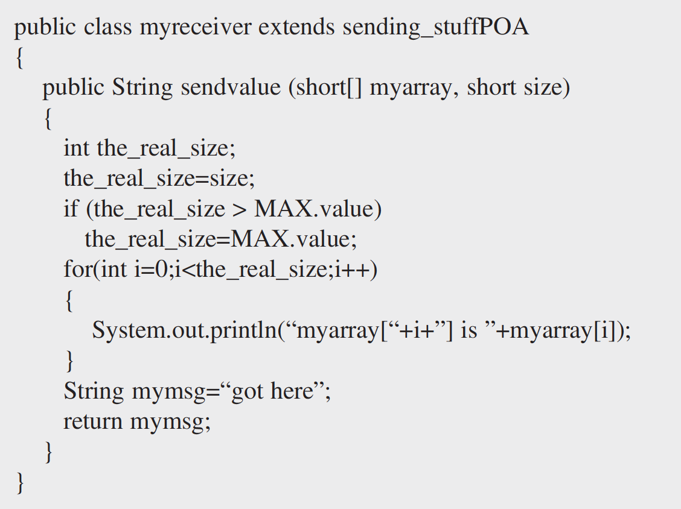
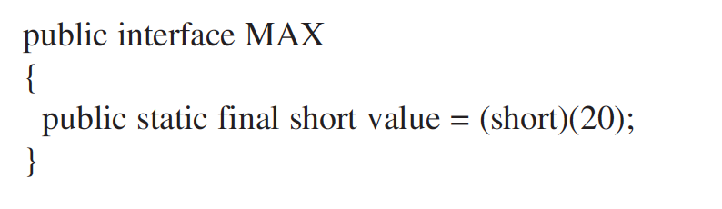
Interface Description Language (IDL)
Example code – in
IDL definition
Java code (servant)

Slide 9
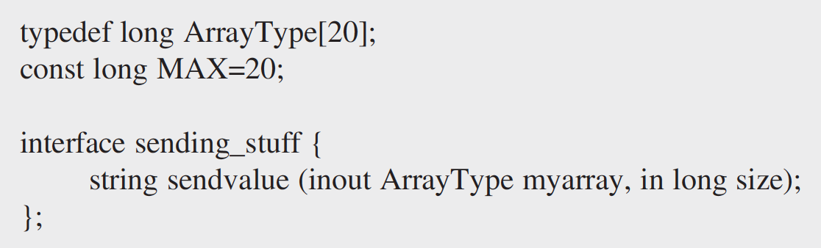
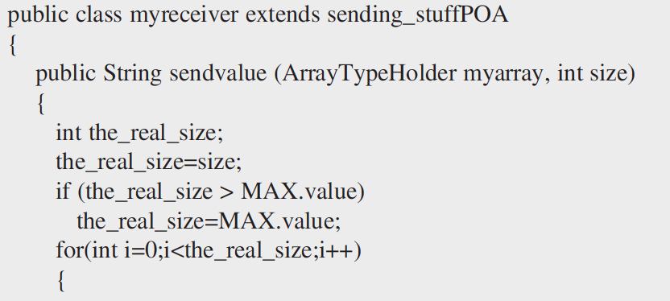
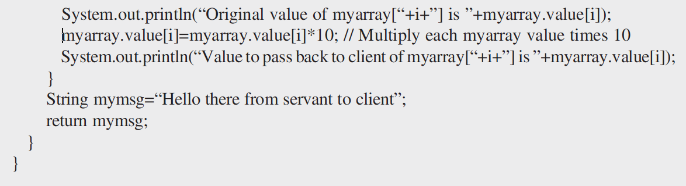
Interface Description Language (IDL)
Example code – inout
IDL definition
Java code (servant)

Slide 10
Thank You!
In our next session:
CORBA Addressing

